Slide 1
Instructions for use
This resource aligns to the learning in Stage 3 Year A Unit 16 and revisits content from earlier sample units.
Classroom teachers are encouraged to add, edit and adapt to meet the needs of their students.
Save a copy of the file to make changes to the slide deck. Go to File > Download a Copy (this downloads a copy to the computer to edit in the PowerPoint app).
To convert the PowerPoint to Google Slides:
  Upload the file into Google Drive and open it.
  Go to File > Save as Google Slides.
  (Note – conversion may cause formatting changes in the slides.)

Slide 2

Review of Learning
Mathematics Stage 3 – Unit 16
Notes:
Reviews may include a combination of question types, requiring students to recall facts and key ideas, as well as apply their knowledge to solve problems and answer questions. To support active engagement, a mix of techniques should be employed.” (AERO, 2024).
This Review of Learning slide deck revisits key concepts from the following units:
Stage 3 Year A Unit 16
Stage 3 Year A Unit 15
Stage 3 Year A Unit 14
It also includes opportunities to review prior learning in non-number content, supporting consolidation across focus areas.
The review of learning resources include three key task types that support the development of mathematical proficiency through retrieval, spaced practice, and active participation. These practices complement the review phase (activating prior knowledge) embedded within the beginning of each lesson.
1.
Multiple-choice questions/True or false: Designed to promote active retrieval of key concepts and identify common misconceptions in number, supporting consolidation, understanding and fluency.
These questions:
support spaced and interleaved practice
help identify and address common misconceptions
support active recall and immediate feedback
support whole class participation
identify areas requiring reteach
2.
Short-response question sets: Carefully grouped questions that encourage spaced and interleaved practice across multiple focus areas, helping students revisit and apply knowledge from different points in time.
These questions:
have a combination of question types
address a range of focus areas
build automaticity and fluency
support active recall
allow for immediate feedback
identify content requiring reteach
3.
Developing number sense activities: A variety of practical, purposeful tasks that reinforce current learning and build on prior knowledge. These activities promote reasoning, problem-solving and conceptual understanding.
The review of learning resources are designed to work support teaching and learning in mathematics. For the most effective implementation, use the resources flexibly, adapting to meet student learning needs and individual classroom contexts.

Slide 3
Lessons
1
Review of learning 1
5
Review of learning 5
2
Review of learning 2
6
Review of learning 6
3
Review of learning 3
7
Review of learning 7
4
Review of learning 4
8
Review of learning 8
Notes:
Teacher notes:
Click lesson numbers to go to specific lessons
Interactive features can be viewed in slide show

Slide 4
Review of learning 1

Slide 5

Multiple choice (1)
Which of the following includes factors of 30?
A
1, 2, 3, 4, 6, 8, 15, 30
2, 4, 6, 10, 15, 30
B
C
1, 2, 3, 5, 6, 10, 15, 30
D
3, 6, 8, 9, 15, 30
Notes:
This question connects to the content in the developing number sense activity (Activity 1)
Syllabus focus area:
Multiplication relations A

Slide 6

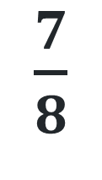
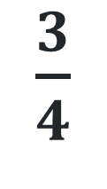
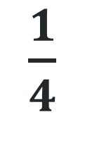
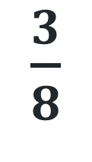
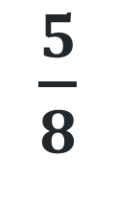
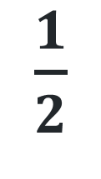
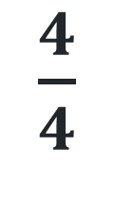
Short response (1)
Draw a number line 0-1.
Order the following fractions:
$\frac{1}{2}$
$\frac{3}{8}$
$\frac{1}{4}$
$\frac{3}{4}$
$\frac{7}{8}$
$\frac{4}{4}$
$\frac{5}{8}$
Notes:
Short response questions provide brisk paced questions focussing on review of current and previous content to support spaced and interleaved practice.
Syllabus focus area:
Representing quantity fractions A

Slide 7
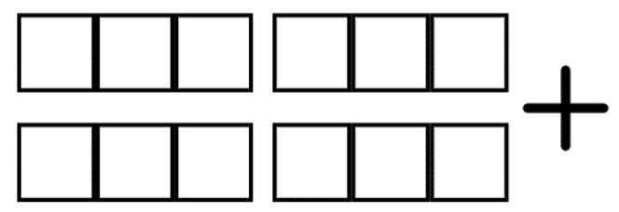
Short response (2)
Record two 6-digit numbers that when added together, make a number close to 1 million.
Notes:
Short response questions provide brisk paced questions focussing on review of current and previous content to support spaced and interleaved practice.
Syllabus focus area:
Additive relations A

Slide 8
Short response (3)
Jesse swam 400m on Monday, 500m on Tuesday, 300m on Wednesday, 600m on Thursday and 200m on Friday.
Record the distance Jesse swam using the abbreviation for kilometres.
Notes:
Short response questions provide brisk paced questions focussing on review of current and previous content to support spaced and interleaved practice.
Syllabus focus area:
Geometric measure A

Slide 9
Short response (4)
Sophie needs to catch the bus to the oval at 3:30 pm and then the 5:45 pm bus home.
Record the times in 24-hour time.
Notes:
Short response questions provide brisk paced questions focussing on review of current and previous content to support spaced and interleaved practice.
Syllabus focus area:
Non-spatial measure A: Time

Slide 10

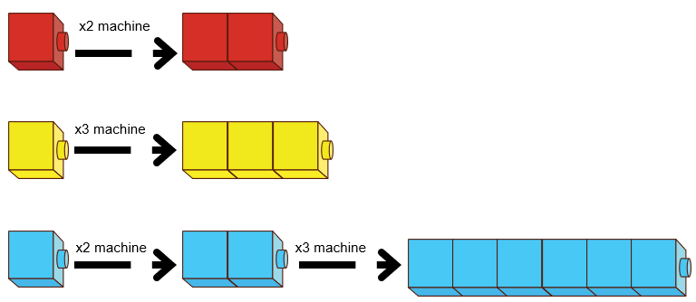
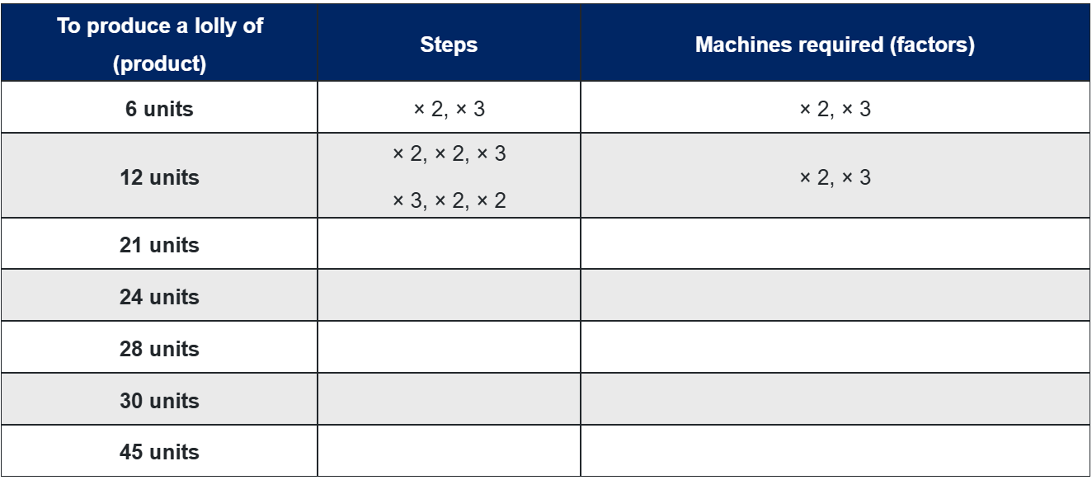
Activity 1 – determining products and factors
Notes:
This is a developing number sense activity.
Number sense refers to a deep understanding of numbers, including their magnitude, relationships, and the effects of operations on them. It supports fluency and understanding, estimation, flexible thinking, and efficient problem-solving. Number sense activities 1–4 ‘activate’ prior number knowledge and support the learning of new content in the unit. Number sense activities 5–8 ‘loop’ back and provide opportunity for spaced practice with concepts and procedures covered in previous units.
Syllabus focus area:
Multiplicative relations A
Determining products and factors
This lesson is an adaptation of Liquorice Factory from Arc Learning Sequences by State of Victoria (Department of Education) and was introduced in Stage 3 Year A Unit 13.
Revise students’ understanding of products and factors.
Product: the result of multiplying 2 or more numbers together. For example, 12 is the product of 4 × 3.
Factors: a number which divides another number without a remainder. For example, 1, 2, 3 and 6 are factors of 6 but 4 and 5 are not.
2. Display Resource 16 – lolly machines (this resource corresponds to Resource 16 – lolly machines in Stage 3, Year A Unit 16).
3. Explain that lollies at a factory are produced by passing through different machines to extend their lengths. For example, a one-unit length of lolly is put through a × 2 machine twice to result in a lolly 4 units in length. Similarly, the lolly can be passed through both the × 2 and × 3 machines to double and then triple the lolly. This will produce a stretched lolly equal to 6 units, or 6 times as long as the original piece.
4. Provide students with Resource 17 – lolly recipes (this resource corresponds to Resource 16 – lolly machines in Stage 3, Year A Unit 16).
5. Demonstrate how a 21-unit length lolly is made using a × 3 and × 7 machine.
6. Display 3 × 7 = 21 on the board.
7. Explain that 3 and 7 are factors of 21.
8. Ask students to record as many combinations of machines as possible.
9. Check for understanding by reviewing student recordings.

Slide 11
Review of learning 2

Slide 12
True or false (1)
Jeremy says 14 is a prime number because it has factors of 1, 2, 7 and 14.
True | False
Notes:
The question on this slide connects to the content being explored in the developing number sense activity (Activity 2)
Syllabus focus area:
Multiplication relations A

Slide 13
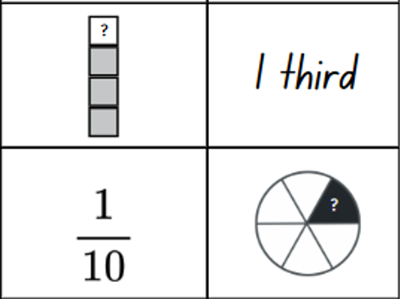
Short response (5)
On a number line from 0 to 1, order the following fractions:
Notes:
Short response questions provide brisk paced questions focussing on review of current and previous content to support spaced and interleaved practice.
Syllabus focus area:
Representing quantity fractions A

Slide 14
Short response (6)
Use a mental strategy to solve:
3597 + 5349
Notes:
Short response questions provide brisk paced questions focussing on review of current and previous content to support spaced and interleaved practice.
Syllabus focus area:
Additive relations A

Slide 15
Short response (7)
Elias trained for the long jump event. His jumps measured 1.54 m, 1.43 m and 1.32 m.
Estimate the total distance using an appropriate unit of measure.
Notes:
Short response questions provide brisk paced questions focussing on review of current and previous content to support spaced and interleaved practice.
Syllabus focus area:
Geometric measure A: Length

Slide 16

Short response (8)
Identify the number of the following 2D shapes:
isosceles triangles
quadrilaterals
equilateral triangles
scalene triangles
Notes:
Short response questions provide brisk paced questions focussing on review of current and previous content to support spaced and interleaved practice.
Syllabus focus area:
Two-dimensional spatial structure A: 2D Shapes

Slide 17
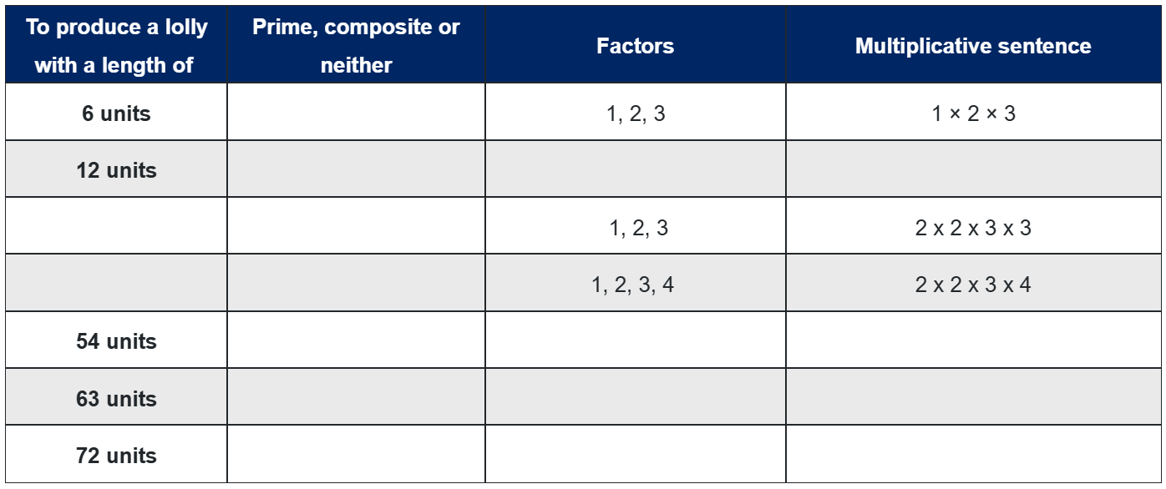
Activity 2 – prime and composite numbers
Notes:
This is a developing number sense activity.
Number sense refers to a deep understanding of numbers, including their magnitude, relationships, and the effects of operations on them. It supports fluency and understanding, estimation, flexible thinking, and efficient problem-solving. Number sense activities 1–4 ‘activate’ prior number knowledge and support the learning of new content in the unit. Number sense activities 5–8 ‘loop’ back and provide opportunity for spaced practice with concepts and procedures covered in previous units.
Syllabus focus area:
Multiplicative relations A
Prime and composite numbers
1. Display Resource 16 – lolly machines from Lesson 1 and a student example of Resource 17 – lolly recipes (these resources correspond to Resource 16 – lolly machines and Resource 17 – lolly recipes in Stage 3, Year A Unit 16).
2. Ask students to explain what machine would be needed to produce a lolly that is 11 units in length.
3. Prompt students to explain their thinking.
4. Explain that 11 is a prime number which means it only has 2 factors, one and itself. It is, therefore, not a length that can be produced using a combination of other machines. Emphasise that one is not a prime number as it does not have 2 distinct factors.
Prime number: a prime number is a positive integer which has exactly 2 distinct factors, itself and one. Modelled as an array, it has only one row. Zero is not an integer and therefore is neither prime nor composite.
Composite number: a non-zero natural number that has a factor other than one and itself. For example, all even numbers besides 2 are composite numbers. Some odd numbers are composite (for example, 21).
5. Provide students with Resource 18 – lolly malfunctions.
6. Demonstrate writing a multiplicative statement with factors for 12. For example, 2 × 2 × 3 = 12.
7. Ask: will it make a difference if the lolly is first passed through the × 2 or × 3 machine. Demonstrate by writing a second multiplicative statement 3 × 2 × 2 = 12.
8. Explain that the associative property applies in multiplication statements as the order in which quantities are multiplied does not change the result.
9. Ask students to fill in the missing values by:
identifying the provided numbers as prime, composite or neither
writing the multiplicative statement to reflect the use of factors to result in a product
using the provided multiplicative statements to determine the product.
10. Check for understanding by reviewing student recordings.

Slide 18
Review of learning 3

Slide 19
Multiple choice (2)
I am thinking of a number. Its factors include:
1, 2, 3, 4, 6 and 8
What number am I?
A | B | C | D
57 | 68 | 96 | 104
Notes:
This question connects to the content in the developing number sense activity (Activity 3)
Syllabus focus area:
Multiplicative relations A

Slide 20
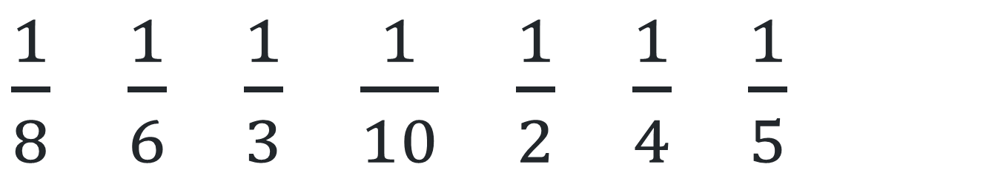
Short response (9)
Order the unit fractions in ascending order on a number line from 0 to 1.
$\frac{1}{8}$ $\frac{1}{6}$ $\frac{1}{3}$ $\frac{1}{10}$ $\frac{1}{2}$ $\frac{1}{4}$ $\frac{1}{5}$
Notes:
Short response questions provide brisk paced questions focussing on review of current and previous content to support spaced and interleaved practice.
Syllabus focus area:
Representing quantity fractions A

Slide 21
Short response (10)
Use the strategies of levelling and constant difference to solve:
456 + 64
289 – 31
Notes:
Short response questions provide brisk paced questions focussing on review of current and previous content to support spaced and interleaved practice.
Syllabus focus area:
Additive relations A

Slide 22
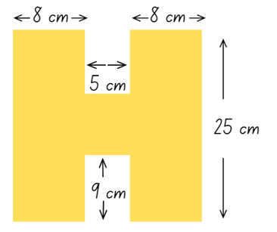
Short response (11)
Find the total perimeter of this composite shape:
Notes:
Short response questions provide brisk paced questions focussing on review of current and previous content to support spaced and interleaved practice.
Syllabus focus area:
Geometric measure A: Length

Slide 23
Short response (12)
Tyrell says a square pyramid has 4 vertices.
Do you agree or disagree? Why?
Notes:
Short response questions provide brisk paced questions focussing on review of current and previous content to support spaced and interleaved practice.
Syllabus focus area:
Three-dimensional spatial structure A: 3DS Objects

Slide 24
Activity 3 – factors of a number
Amira is thinking of a number. Its factors include 1, 2, 3 and 4.
- Jake says it is 48
- Malik says it is 24
- Lucy says it is 71.
Who is correct and why?
Notes:
This is a developing number sense activity.
Number sense refers to a deep understanding of numbers, including their magnitude, relationships, and the effects of operations on them. It supports fluency and understanding, estimation, flexible thinking, and efficient problem-solving. Number sense activities 1–4 ‘activate’ prior number knowledge and support the learning of new content in the unit. Number sense activities 5–8 ‘loop’ back and provide opportunity for spaced practice with concepts and procedures covered in previous units.
Syllabus focus area:
Multiplicative relations A
Factors of a number
Display Resource 19 – student responses (this resource correspond to Resource 19 – student responses in Stage 3, Year A Unit 16).
Explain: I am thinking of a number. Its factors include 1, 2, 3 and 4.
Ask, and partners turn and talk to answer:
What are the factors of 48, 24 and 71?​
Which answer is correct? 24, 48 or 71?
Why is 71 not a possible answer?
Why are 24 and 48 both correct?
4. Check for understanding by selecting students to share their understanding of factors.
The teacher can pose the following questions after students demonstrate accuracy in solving the first two questions.
Why is 71 not a possible answer?
Why are 24 and 48 both correct?

Slide 25
Review of learning 4

Slide 26
True or false (2)
9 is a factor of 48.
True | False
Communicate your reasoning.
Notes:
The question on this slide connects to the content being explored in the developing number sense activity (Activity 4)
Syllabus focus area:
Multiplicative relations A

Slide 27
Short response (13)
Record 10%, or one-tenth, of the following:
130
250
70
620
22
Notes:
Short response questions provide brisk paced questions focussing on review of current and previous content to support spaced and interleaved practice.
Syllabus focus area:
Represents numbers B

Slide 28
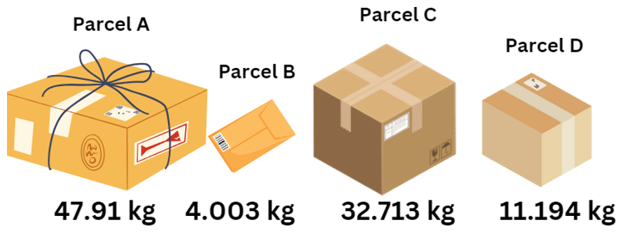
Short response (14)
Which combination of parcels will balance a set of scales?
Notes:
Short response questions provide brisk paced questions focussing on review of current and previous content to support spaced and interleaved practice.
Syllabus focus area:
Additive relations A

Slide 29
Short response (15)
Pop’s garden needs 60m of fencing. What could be the length and width of the garden?
Communicate your thinking.
Notes:
Short response questions provide brisk paced questions focussing on review of current and previous content to support spaced and interleaved practice.
Syllabus focus area:
Geometric measure A: Length

Slide 30
Short response (16)
The playground needs new turf. The length is 28 metres, and the width is 7 metres. Mr Bancroft estimates that 200 square metres of turf is needed to cover the playground. Is this enough? Explain the strategies you used.
Notes:
Short response questions provide brisk paced questions focussing on review of current and previous content to support spaced and interleaved practice.
Syllabus focus area:
Two-dimensional spatial structure A: Area

Slide 31
Activity 4 – determining factors
Identify as many factors as possible.
64
Notes:
This is a developing number sense activity.
Number sense refers to a deep understanding of numbers, including their magnitude, relationships, and the effects of operations on them. It supports fluency and understanding, estimation, flexible thinking, and efficient problem-solving. Number sense activities 1–4 ‘activate’ prior number knowledge and support the learning of new content in the unit. Number sense activities 5–8 ‘loop’ back and provide opportunity for spaced practice with concepts and procedures covered in previous units.
Syllabus focus area:
Multiplicative relations A
This activity can be completed as a Number Talk.
Display the number 64 on the board or large paper.
Ask students to identify the factors of 64.
Record the numbers students choose around the number 64.
Check for student understanding by asking students to explain why they chose that number, recording their strategy and addressing any misconceptions.
Repeat with other numbers. For example, 48 or 77.

Slide 32
Review of learning 5

Slide 33
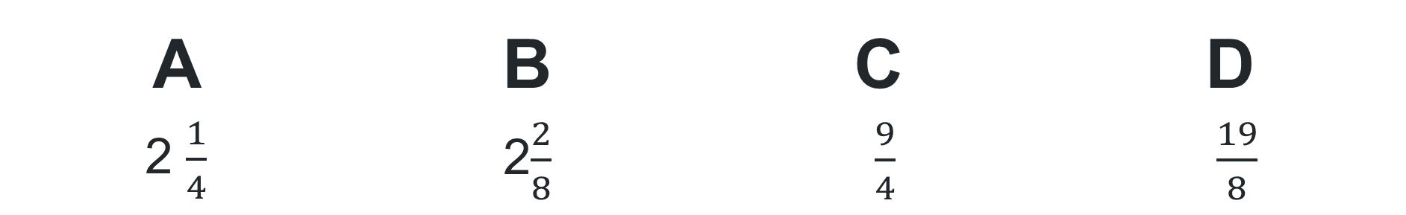

Multiple choice (3)
1 $\frac{2}{4}$ + $\frac{3}{4}$ is not equal to:
A | B | C | D
2 $\frac{1}{4}$ | 2$\frac{2}{8}$ | $\frac{9}{4}$ | $\frac{19}{8}$
Notes:
This question connects to the content in the developing number sense activity (Activity 5)
Syllabus focus area:
Representing quantity fractions A

Slide 34
Short response (17)
Sarah wants to buy a new pair of athletic shoes which cost $200. There is a 25% discount.
How much will Sarah pay?
Notes:
Short response questions provide brisk paced questions focussing on review of current and previous content to support spaced and interleaved practice.
Syllabus focus area:
Represents numbers B

Slide 35
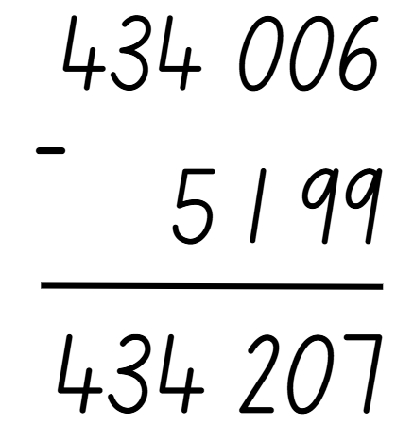
Short response (18)
Use estimation to determine the reasonableness of this answer.
Communicate your thinking.
Notes:
Short response questions provide brisk paced questions focussing on review of current and previous content to support spaced and interleaved practice.
Syllabus focus area:
Additive relations A

Slide 36
Short response (19)
Identify the suitable unit to measure the mass of the following items, choosing from grams, kilograms, and tonnes:
a pencil
a watermelon
a puppy
a truck
Notes:
Short response questions provide brisk paced questions focussing on review of current and previous content to support spaced and interleaved practice.
Syllabus focus area:
Additive relations B

Slide 37
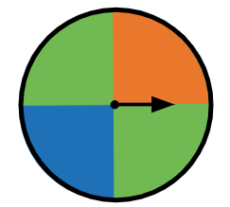
Short response (20)
Identify the possible outcomes which are
equally likely.
Communicate your thinking.
Notes:
Short response questions provide brisk paced questions focussing on review of current and previous content to support spaced and interleaved practice.
Syllabus focus area:
Chance A

Slide 38
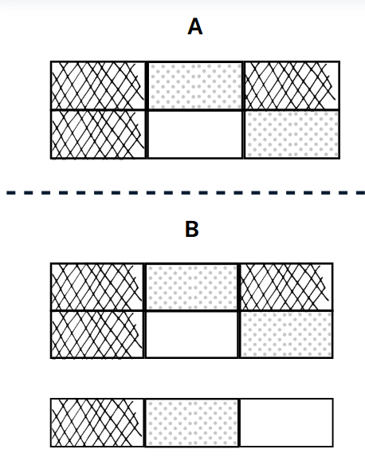
Activity 5 – adding and subtracting fractions in area models
Record at least 4 addition or subtraction sentences that match image A.
Record at least 4 addition or subtraction sentences that match image B.
Notes:
This is a developing number sense activity.
Number sense refers to a deep understanding of numbers, including their magnitude, relationships, and the effects of operations on them. It supports fluency and understanding, estimation, flexible thinking, and efficient problem-solving. Number sense activities 1–4 ‘activate’ prior number knowledge and support the learning of new content in the unit. Number sense activities 5–8 ‘loop’ back and provide opportunity for spaced practice with concepts and procedures covered in previous units.
Syllabus focus area:
Representing quantity fractions A
Adding and subtracting fractions in area models
1. Display Resource 20 – fraction area models (this resource correspond to Resource 20 – fraction area models in Stage 3, Year A Unit 16).
2. Explain that for image A:
the large rectangle represents a whole or 1
each section represents one-sixth ( $\frac{1}{6}$ )
the dotted area can be named two-sixths ( $\frac{2}{6}$) or one-third ( $\frac{1}{3}$ )
the hatched area can be named three-sixths ( $\frac{3}{6}$) or one-half ( $\frac{1}{2}$ ).
3. Students record at least 4 addition or subtraction sentences that match image A. Examples may include:
$\frac{1}{6}$ + $\frac{2}{6}$+ $\frac{3}{6}$= 1
$\frac{3}{6}$+ $\frac{2}{6}$= $\frac{5}{6}$
$\frac{3}{6}$ – $\frac{2}{6}$= $\frac{1}{6}$
1 – $\frac{1}{6}$= $\frac{5}{6}$.
4. Check for understanding by selecting students to share their responses.
5. Explain to students they will now record at least 4 addition or subtraction sentences that match image B. Examples may include:
$\frac{4}{6}$+ $\frac{3}{6}$+ $\frac{2}{6}$ = $\frac{9}{6}$ = $1\frac{1}{2}$
$\frac{4}{6}$+ $\frac{3}{6}$= $\frac{7}{6}$= $1\frac{1}{6}$
$1\frac{3}{6}$ − $\frac{2}{6}$= $1\frac{1}{6}$ = $\frac{7}{6}$.
6. Check for understanding by selecting students to share their responses.
Note: in the syllabus, the expression ‘fraction greater than one’ is used instead of the term ‘improper fraction’ or ‘mixed numeral.’

Slide 39
Review of learning 6

Slide 40

True or false (3)
1 $\frac{2}{8}$ - $\frac{5}{8}$ = $\frac{15}{8}$
True | False
Communicate your reasoning.
Notes:
The question on this slide connects to the content being explored in the developing number sense activity (Activity 6)
Syllabus focus area:
Representing quantity fractions A

Slide 41
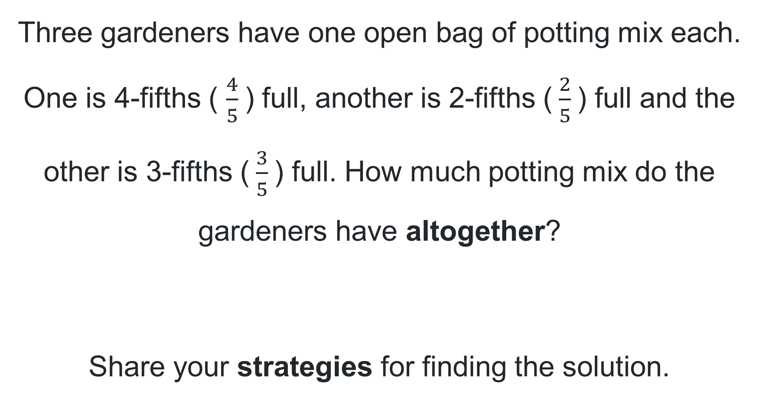
Short response (21)
Three gardeners have one open bag of potting mix each. One is 4-fifths ( $\frac{4}{5}$) full, another is 2-fifths ($\frac{2}{5}$) full and the other is 3-fifths ($\frac{3}{5}$) full. How much potting mix do the gardeners have altogether?
Share your strategies for finding the solution.
Notes:
Short response questions provide brisk paced questions focussing on review of current and previous content to support spaced and interleaved practice.
Syllabus focus area:
Representing quantity fractions A

Slide 42
Short response (22)
Use rounding and estimation to solve this number sentence.
16 429 + 648 957
Notes:
Short response questions provide brisk paced questions focussing on review of current and previous content to support spaced and interleaved practice.
Syllabus focus area:
Additive relations A

Slide 43
Short response (23)
Which object in the classroom would be most appropriate to measure in kilograms?
Communicate your thinking.
Notes:
Short response questions provide brisk paced questions focussing on review of current and previous content to support spaced and interleaved practice.
Syllabus focus area:
Non spatial measure A: Mass

Slide 44
Short response (24)
Mrs Leaver is organising a class picnic and needs one litre of water, 550 mL of orange juice and 250 mL of milk. How many litres does Mrs Leaver need to organize?
Answer using decimal notation.
Notes:
Short response questions provide brisk paced questions focussing on review of current and previous content to support spaced and interleaved practice.
Syllabus focus area:
Three-dimensional spatial structure A

Slide 45
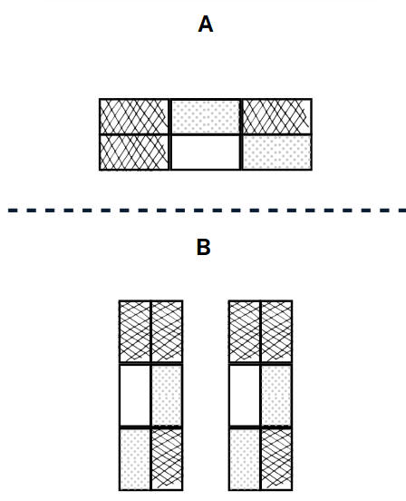
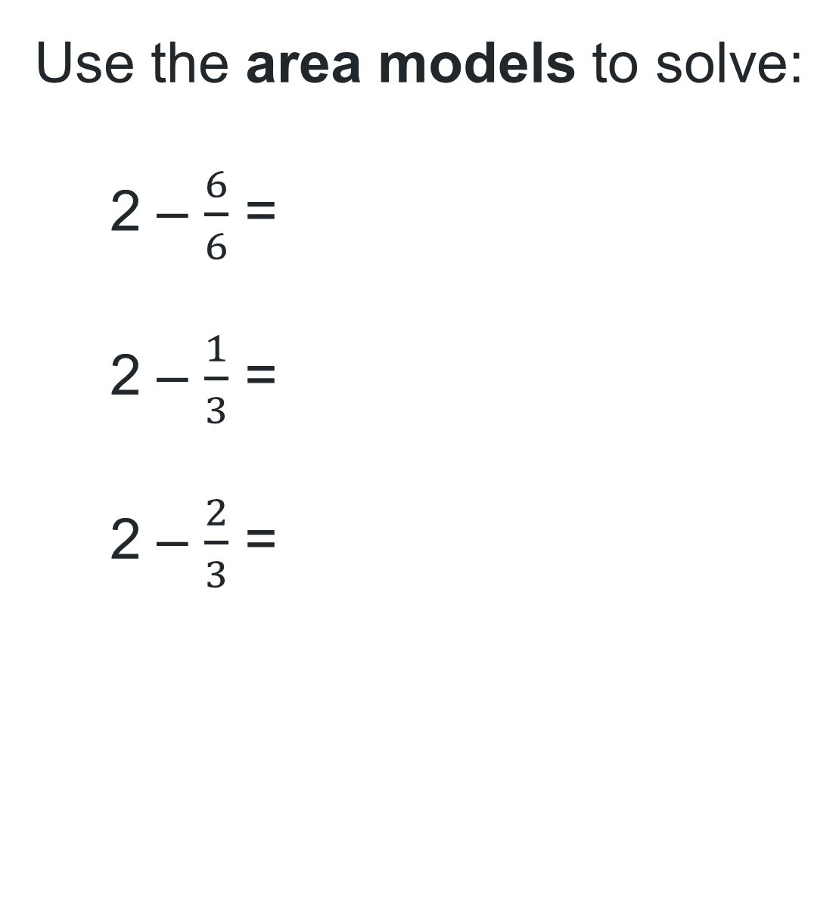
Activity 6 – calculating fractions in area models
Use the area models to solve:
2 – $\frac{6}{6}$ =
2 – $\frac{1}{3}$ =
2 – $\frac{2}{3}$ =
Notes:
This is a developing number sense activity.
Number sense refers to a deep understanding of numbers, including their magnitude, relationships, and the effects of operations on them. It supports fluency and understanding, estimation, flexible thinking, and efficient problem-solving. Number sense activities 1–4 ‘activate’ prior number knowledge and support the learning of new content in the unit. Number sense activities 5–8 ‘loop’ back and provide opportunity for spaced practice with concepts and procedures covered in previous units.
Syllabus focus area:
Representing quantity fractions A
Calculating fractions in area models
Note: the equations noted in point 2 may be written on the board, after students’ complete section 1.
Alternatively, this section can be hidden until section 1 is complete.
1. Display Resource 21 – new area models (this resource correspond to Resource 21 – new area models in Stage 3, Year A Unit 16).
Ask the following questions, and students record responses to:
If image A represents a whole, what fraction is it partitioned into? (sixths)
What is shown in image B? (two wholes, in a different orientation)
What fraction is represented by the cross-hatched sections in image B? ($\frac{6}{6}$ or one whole)
What fraction is represented by the dotted sections in image B? ($\frac{4}{6}$ or $\frac{2}{3}$)
What fraction is represented by the white sections in image B? ($\frac{2}{6}$ or $\frac{1}{3}$)
3. Display the following equations on the board:
2 – $\frac{6}{6}$ = _?
2 – $\frac{1}{3}$ = _?
2 – $\frac{2}{3}$ = _?
4. Ask students to Think-Pair-Share to complete each equation verbally.
5. Select students to share their responses and explain their thinking.

Slide 46
Review of learning 7

Slide 47
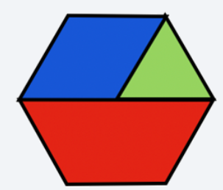
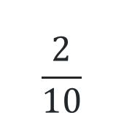
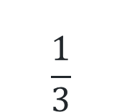
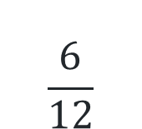
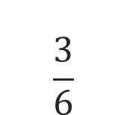
Multiple choice (4)
What fraction of the hexagon is the blue rhombus?
$$\frac{3}{6}$$
A
$$\frac{6}{12}$$
B
$$\frac{1}{3}$$
C
$$\frac{2}{10}$$
D
Notes:
This question connects to the content in the developing number sense activity (Activity 7)
Syllabus focus area:
Representing quantity fractions B

Slide 48
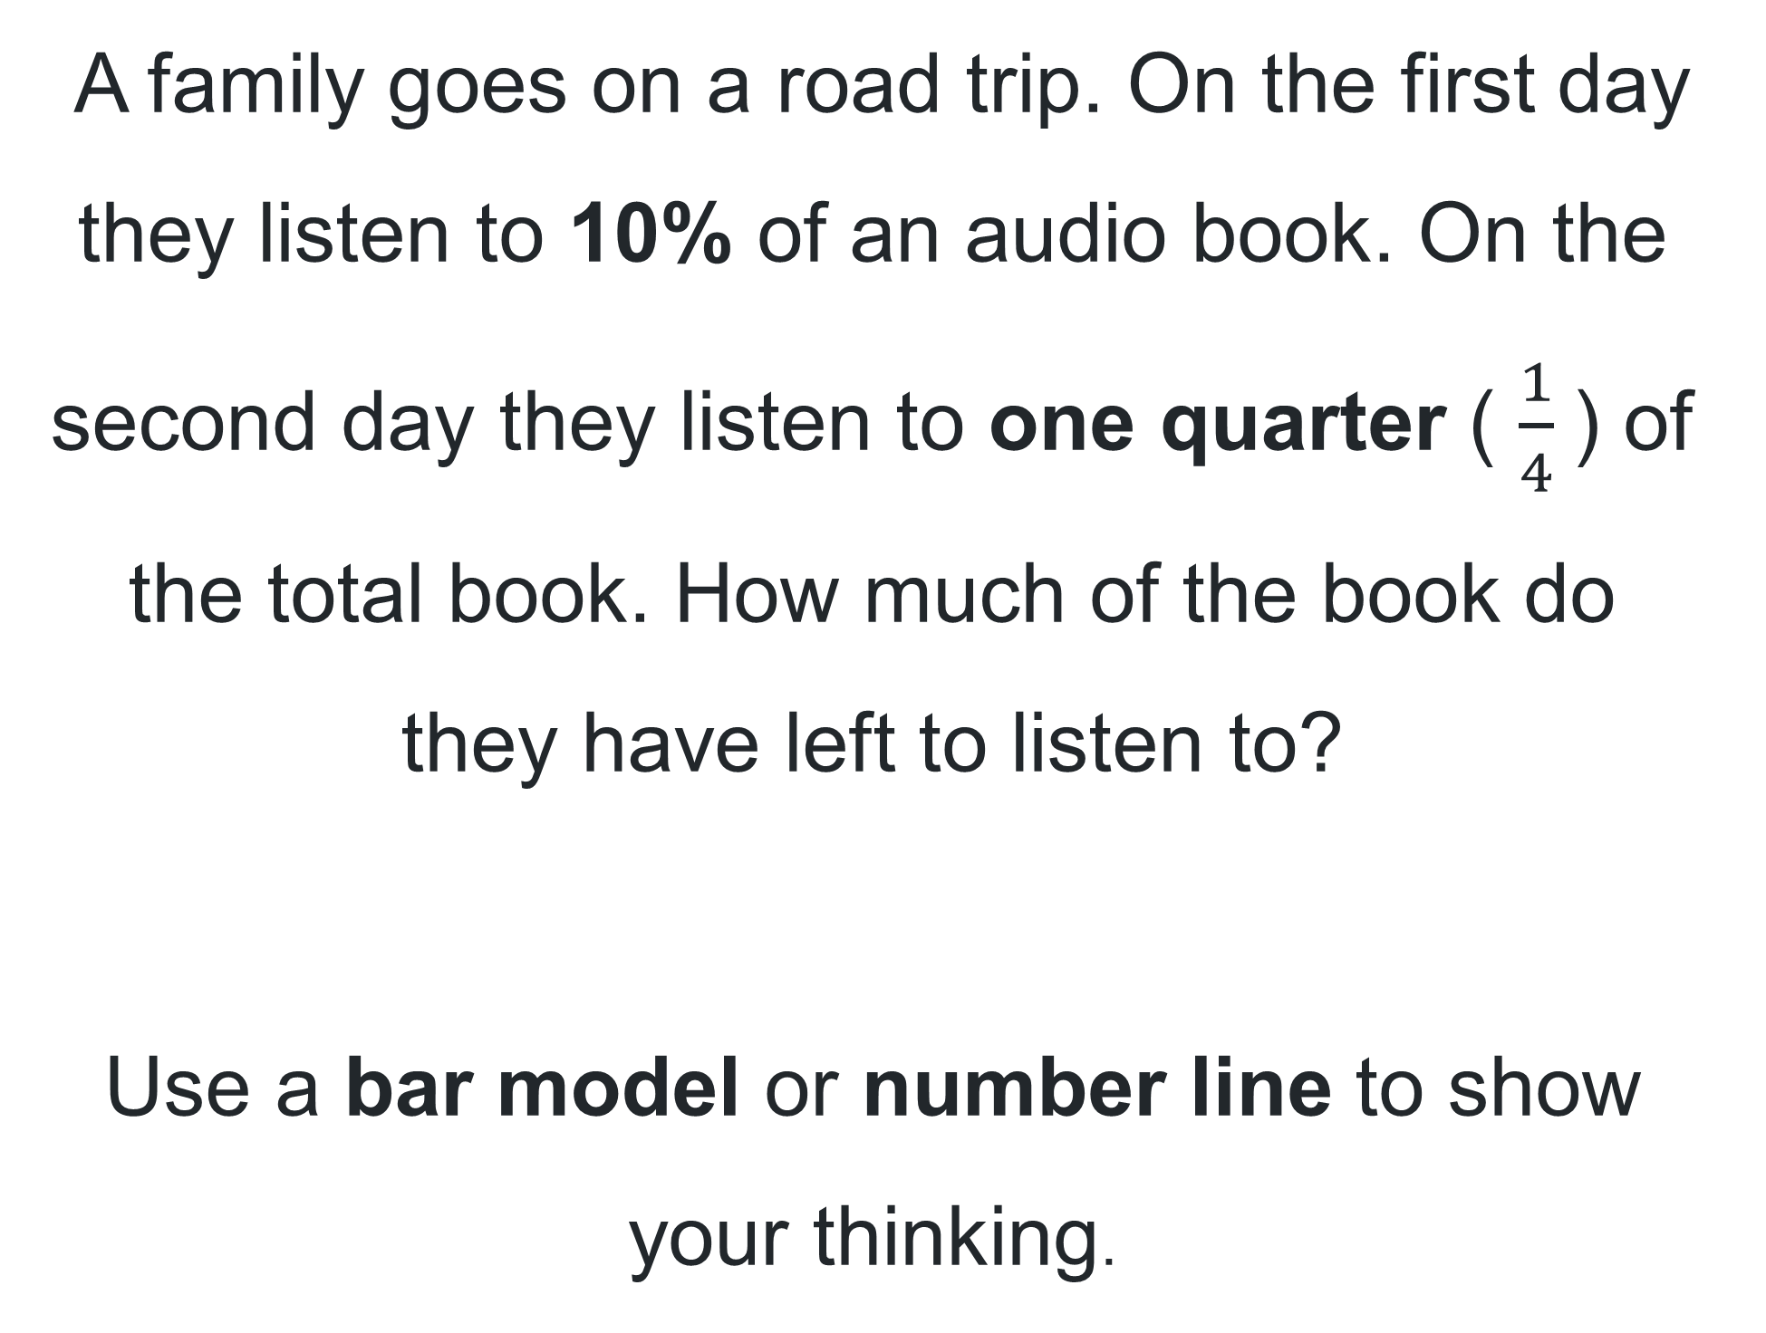
Short response (25)
A family goes on a road trip. On the first day they listen to 10% of an audio book. On the second day they listen to one quarter ( $\frac{1}{4}$) of the total book. How much of the book do they have left to listen to?
Use a bar model or number line to show your thinking.
Notes:
Short response questions provide brisk paced questions focussing on review of current and previous content to support spaced and interleaved practice.
Syllabus focus area:
Representing quantity fractions A

Slide 49
Short response (26)
Use estimation to find the answer:
43 893 + 92 107
Justify the reasonableness of your solution.
Notes:
Short response questions provide brisk paced questions focussing on review of current and previous content to support spaced and interleaved practice.
Syllabus focus area:
Additive relations A

Slide 50
Short response (27)
Record the following masses in decimal notation:
2 kilograms and 350 grams
1 kilogram and 982 grams
7 kilograms and 43 grams
Notes:
Short response questions provide brisk paced questions focussing on review of current and previous content to support spaced and interleaved practice.
Syllabus focus area:
Non spatial measure A

Slide 51
Short response (28)
Describe how to use a protractor to measure an angle less than 90°.
Notes:
Short response questions provide brisk paced questions focussing on review of current and previous content to support spaced and interleaved practice.
Syllabus focus area:
Geometric measure A: Angles

Slide 52
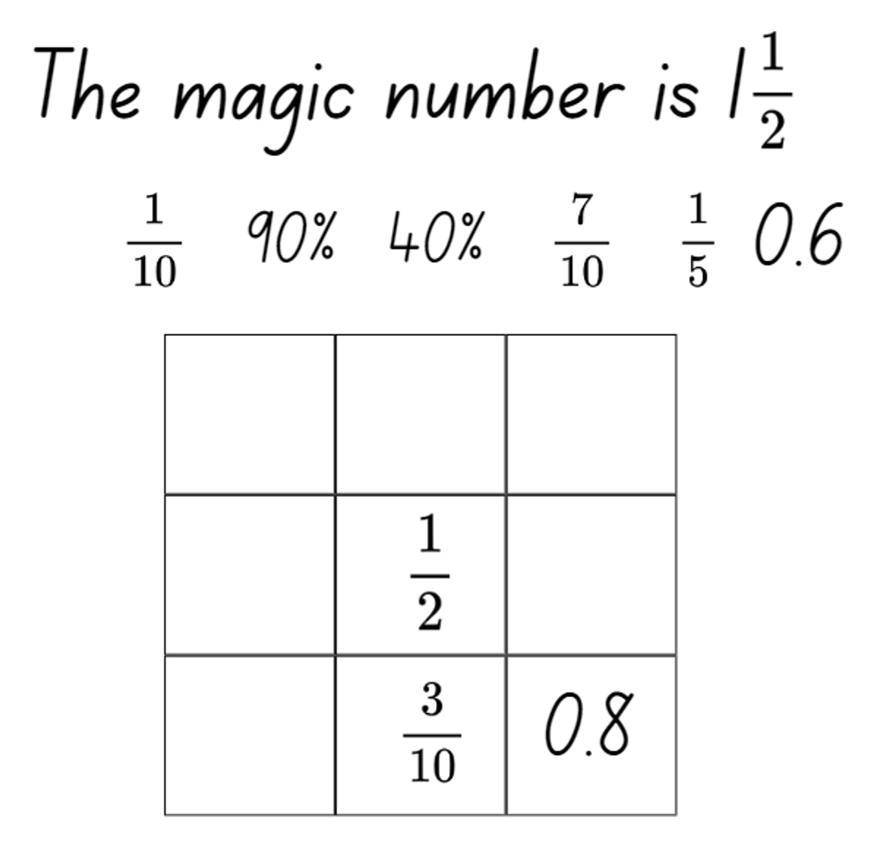
Activity 7 – equivalent fractions, decimals and percentages
Notes:
This is a developing number sense activity.
Number sense refers to a deep understanding of numbers, including their magnitude, relationships, and the effects of operations on them. It supports fluency and understanding, estimation, flexible thinking, and efficient problem-solving. Number sense activities 1–4 ‘activate’ prior number knowledge and support the learning of new content in the unit. Number sense activities 5–8 ‘loop’ back and provide opportunity for spaced practice with concepts and procedures covered in previous units.
Syllabus focus area:
Representing quantity fractions B
Equivalent fractions, decimals and percentages
Display Resource 22 – magic square (this resource corresponds to Resource 22 – magic square in Stage 3, Year A Unit 16).
Explain that this is a form of puzzle where each fraction needs to be placed in a box so that when added, the rows, diagonals and columns add up to one and a half.
Explain the explicit connections between fractions, decimals and percentages.
Ask students to explain what they notice when they look at the fractions.
Explain that the magic number is one and a half.
Ask students to Think-Pair-Share another way to make one and a half by adding the fractional parts.
Prompt students to solve the puzzle in a small group of 3.
8. Check for understanding by selecting students to share their strategies and solutions .
This activity is an adaptation of Magic Square Fun by Learn With Math Games.com and was introduced in Stage 3 Year A Unit 4.

Slide 53
Review of learning 8

Slide 54
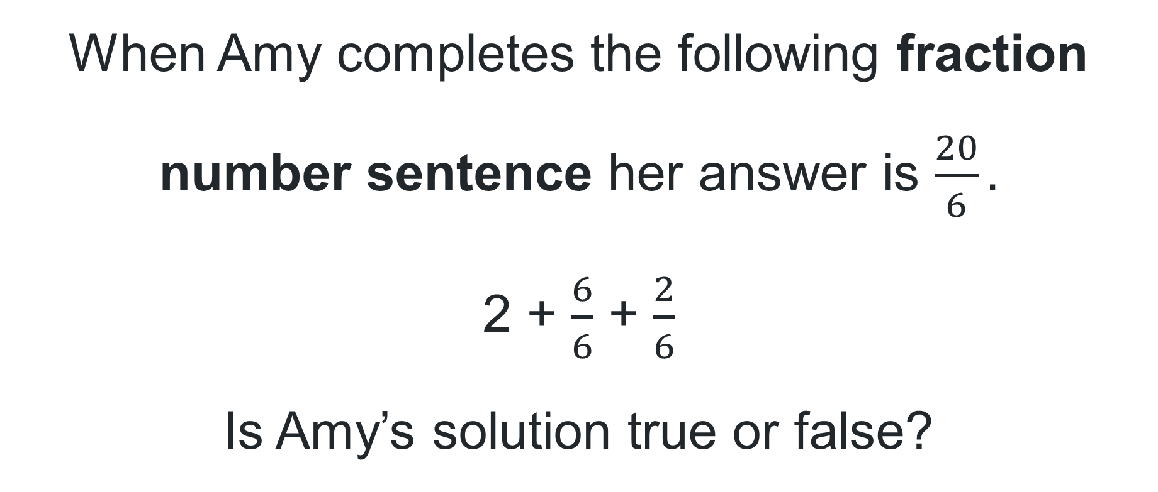
True or false (4)
When Amy completes the following fraction number sentence her answer is $\frac{20}{6}.$
2 + $\frac{6}{6}$ + $\frac{2}{6}$
Is Amy’s solution true or false?
True | False
Notes:
The question on this slide connects to the content being explored in the developing number sense activity (Activity 8)
Syllabus focus area:
Representing quantity fractions A

Slide 55

Short response (29)
Write the following as a fraction number sentence and solve:
yellow circles + white squares + star
Notes:
Short response questions provide brisk paced questions focussing on review of current and previous content to support spaced and interleaved practice.
Syllabus focus area:
Representing quantity fractions A

Slide 56
Short response (30)
Estimate the total distance:
Broken Hill, Wilyakali Country to Wilcannia, Barkindji Country: 197 kilometres
Wilcannia to Dubbo, Wiradjuri Country: 557 kilometres
Dubbo to Gunnedah, Kamilaroi Country: 248 kilometres
Gunnedah to Armidale, Anaiwan Country: 179 kilometres
Armidale to Yamba, Yaegl Country: 258 kilometres
Communicate the reasonableness of your estimation.
Notes:
Short response questions provide brisk paced questions focussing on review of current and previous content to support spaced and interleaved practice.
Syllabus focus area:
Additive relations A

Slide 57
Short response (31)
Interpret the decimal notation for the following masses:
4.8 kg is the same as ___ g
0.875 kg is the same as ___ g
1.04 kg is the same as ___ g
Notes:
Short response questions provide brisk paced questions focussing on review of current and previous content to support spaced and interleaved practice.
Syllabus focus area:
Non spatial measure A: Mass

Slide 58
Short response (32)
3HD | Vet to the rescue! 5:28pm | Antiques world 6:33pm | Journey to space 7:31pm | Crime scene 8:30pm | Forgotten 10:59pm | League cup final 12:15am
Channel 4 | Robot wars extreme 1750 | Cartoon frenzy! 1833 | World news 1903 | Beyond the news 1931 | Airport emergency 2000 | Movie: Space Wars 2030 | Extreme sports update 2328 | International darts 2345
Grandma wants to watch Beyond the news, Crime scene and Extreme sports update on different television channels. Will she be able to watch all television shows?
Communicate your thinking.
Notes:
Short response questions provide brisk paced questions focussing on review of current and previous content to support spaced and interleaved practice.
Syllabus focus area:
Non-spatial measure A: Time

Slide 59
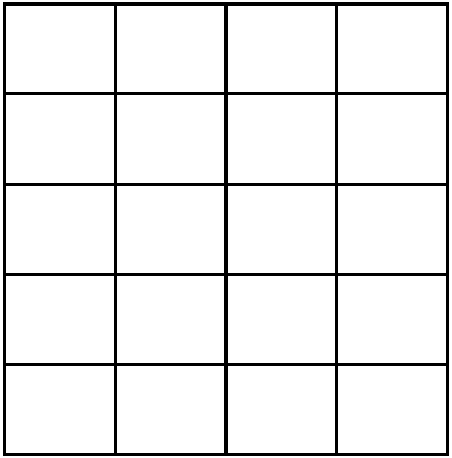
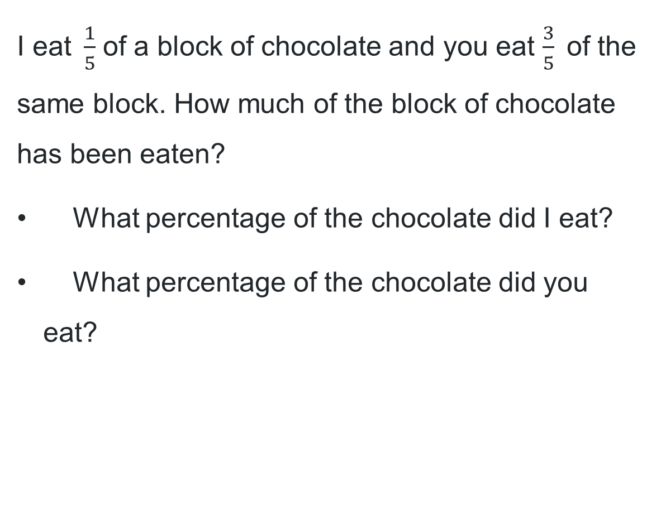
Activity 8 – solving problems with fractions (same denominator)
Example chocolate block
I eat$\frac{1}{5}$ of a block of chocolate and you eat $\frac{3}{5}$of the same block. How much of the block of chocolate has been eaten?
What percentage of the chocolate did I eat?
What percentage of the chocolate did you eat?
Notes:
This is a developing number sense activity.
Number sense refers to a deep understanding of numbers, including their magnitude, relationships, and the effects of operations on them. It supports fluency and understanding, estimation, flexible thinking, and efficient problem-solving. Number sense activities 1–4 ‘activate’ prior number knowledge and support the learning of new content in the unit. Number sense activities 5–8 ‘loop’ back and provide opportunity for spaced practice with concepts and procedures covered in previous units.
Syllabus focus area:
Representing quantity fractions A
Solving problems with fractions (same denominator)
Ask: I eat$\frac{1}{5}$ of a block of chocolate and you eat $\frac{3}{5}$ of the same block. How much of the block of chocolate has been eaten?
Provide students with Resource 23 – chocolate block to represent the chocolate problem using an area model (this resource corresponds to Resource 23 – chocolate block in Stage 3, Year A Unit 16).
Prompt students to solve the following questions on Resource 23 – chocolate block:
What percentage of the chocolate did I eat?
What percentage of the chocolate did you eat?

Slide 60
Double Venn diagram
Object 1
Object 2
Features similar to both objects
Features of object 1
Features of object 2

Slide 61
Frayer
Definition
Facts/Characteristics
Word, term, concept
Examples
Non-examples

Slide 62
Spider map
Idea
Subject

Slide 63
Cline
Concept 1
Concept 2
Word
Word
Word
Word
Word
Word
Word
Word
Word
Word
Word

Slide 64

Compare and contrast
Notes:
Use the arrows to navigate between related activities.
Hyperlink each arrow to compare between related slides.

Slide 65
Multiple choice (1)
A
B
C
D
Notes:
This question connects to the content in the developing number sense activity (Activity 1)
This question can:
support spaced and interleaved practice
help identify and address common misconceptions
support active recall and immediate feedback
support whole class participation
identify areas requiring reteach
Teachers are encouraged to adapt and contextualise for their contexts.

Slide 66
Multiple choice (2)
A
B
C
D
Notes:
This question connects to the content in the developing number sense activity (Activity 1)
Syllabus focus area:
Multiplicative relations A
This question can:
support spaced and interleaved practice
help identify and address common misconceptions
support active recall and immediate feedback
support whole class participation
identify areas requiring reteach
Teachers are encouraged to adapt and contextualise for their contexts.

Slide 67
References (1)
This presentation contains NSW Curriculum and syllabus content. The NSW Curriculum is developed by the NSW Education Standards Authority. This content is prepared by NESA for and on behalf of the Crown in the right of the State of New South Wales. The material is protected by Crown copyright.
Please refer to the NESA Copyright Disclaimer for more information https://educationstandards.nsw.edu.au/wps/portal/nesa/mini-footer/copyright.
NESA holds the only official and up-to-date versions of the NSW Curriculum and syllabus documents. Please visit the NSW Education Standards Authority (NESA) website https://educationstandards.nsw.edu.au/wps/portal/nesa/home and the NSW Curriculum website https://curriculum.nsw.edu.au.
Mathematics Syllabus K-10 © Syllabus NSW Education Standards Authority (NESA) for and on behalf of the Crown in right of the State of New South Wales, 2022.
National Numeracy Learning Progression © Australian Curriculum, Assessment and Reporting Authority (ACARA) 2010 to present, unless otherwise indicated. This material was downloaded from the Australian Curriculum website (National Numeracy Learning Progression) (accessed 6 May 2025) and was not modified.
Barton C (n.d.) ‘Venn Diagram Rich Tasks’, Venn Diagram Activities, Mr Barton maths website, accessed 6 May 2025.
Burns M (2015) Fix It: An Activity for Ordering Fractions, MB math website, accessed 6 May 2025.
Clarke D and Roche A (2009) ‘Students’ fraction comparison strategies as a window into robust understanding and possible pointers for instruction’, Educational Studies in Mathematics, 72(1):127–138, doi:10.1007/s10649-009-9198-9, accessed 6 May 2025.
State of Victoria (Department of Education) (2020) ‘Liquorice Factory’ It’s All in the Numbers, Arc Learning Sequences website, accessed 28 February 2024.
www.learn-with-math-games.com (n.d.) Magic Square Fun, learn-with-math-games.com website, accessed 6 May 2025.
Xiaobo S and Harrington T (2022) 'Teaching word-problem solving through tape diagrams', Mathematics Teacher: Learning and Teaching PK–12, 115(3):170–182.

Slide 68
Copyright
© State of New South Wales (Department of Education), 2025
The copyright material published in this resource is subject to the Copyright Act 1968 (Cth) and is owned by the NSW Department of Education or, where indicated, by a party other than the NSW Department of Education (third-party material).
Copyright material available in this resource and owned by the NSW Department of Education is licensed under a Creative Commons Attribution 4.0 International (CC BY 4.0) license.
This license allows you to share and adapt the material for any purpose, even commercially.
Attribution should be given to © State of New South Wales (Department of Education), 2025.
Material in this resource not available under a Creative Commons license:
the NSW Department of Education logo, other logos and trademark-protected material
Material owned by a third party that has been reproduced with permission. You will need to obtain permission from the third party to reuse its material.
Links to third-party material and websites
Please note that the provided (reading/viewing material/list/links/texts) are a suggestion only and implies no endorsement, by the New South Wales Department of Education, of any author, publisher, or book title. School principals and teachers are best placed to assess the suitability of resources that would complement the curriculum and reflect the needs and interests of their students.
If you use the links provided in this document to access a third party’s website, you acknowledge that the terms of use, including licence terms set out on the third-party’s website apply to the use which may be made of the materials on that third-party website or where permitted by the Copyright Act 1968 (Cth). The department accepts no responsibility for content on third-party websites.

